Slide 1


Raspberry Pi:
Opening and Setting
up a mini Linux dev Environment
Ricardo A. Parodi
dataemotion@gmail.com
April 17th, 2013

Slide 2
History:
http://en.wikipedia.org/wiki/Raspberry_Pi
http://www.raspberrypi.org/faqs

Slide 3
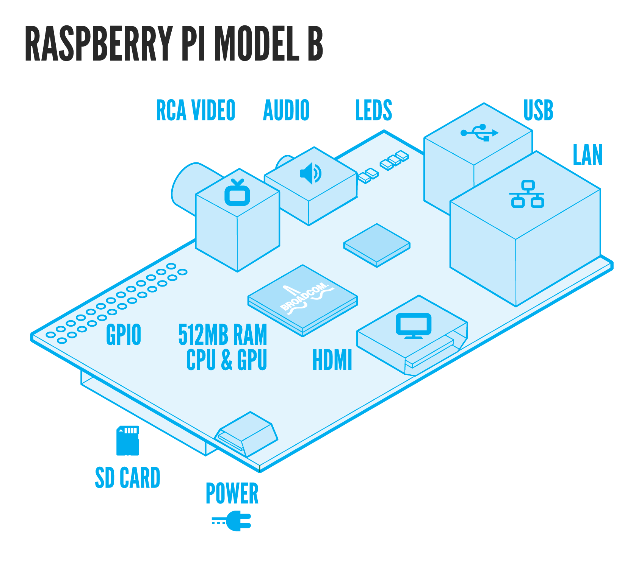
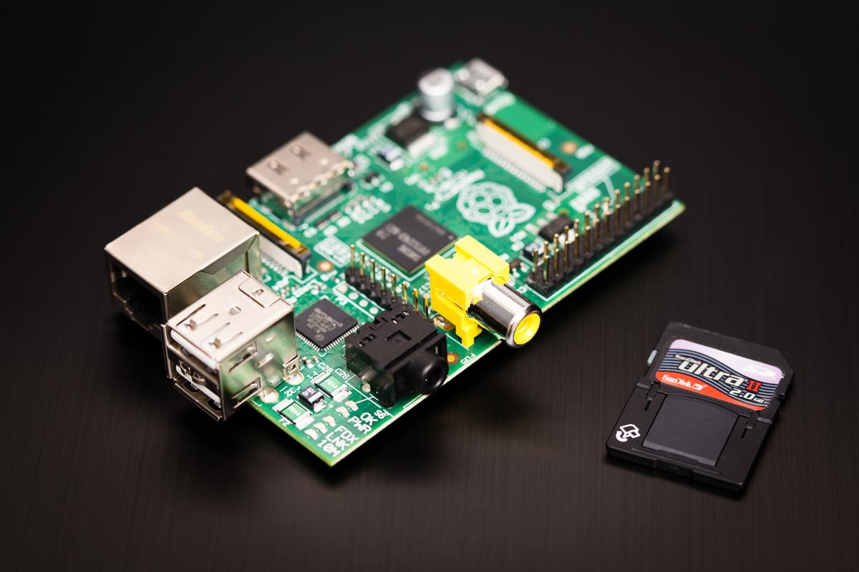
What is a Raspberry Pi?
All sordid details at:
http://www.raspberrypi.org/faqs

Slide 4
Basic Shopping List:
Online:
Raspberry Pi
Powered USB hub
SD Card (8GB)
Power Adapter
Micro WiFi adapter (optional)
Look in your closet for:
USB Keyboard
USB Mouse

Slide 5
First Steps:
Go to www.raspberrypi.org/downloads
  Get your Linux distro image - I'll use the Debian "wheezy"
Go to http://sourceforge.net/projects/win32diskimager/
(there is a link to it from www.raspberrypi.org/downloads page)
  Get and install Win 32 Disk Imager (well, unzip it)
Burn the Debian "wheezy" image to your SD card
MAKE SURE YOU BURN TO THE SD
AND NOT YOUR HARD DRIVE

Slide 6
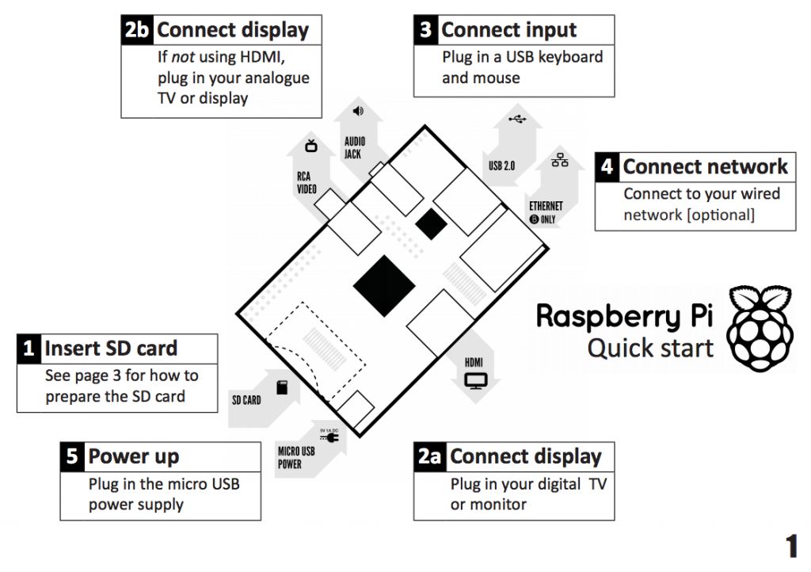
Put it all together:

Slide 7
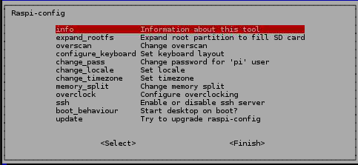
First Boot:
You can always get back to these settings from a terminal window and typing:
sudo raspi-config
Default username/passwd: pi/raspberry

Slide 8
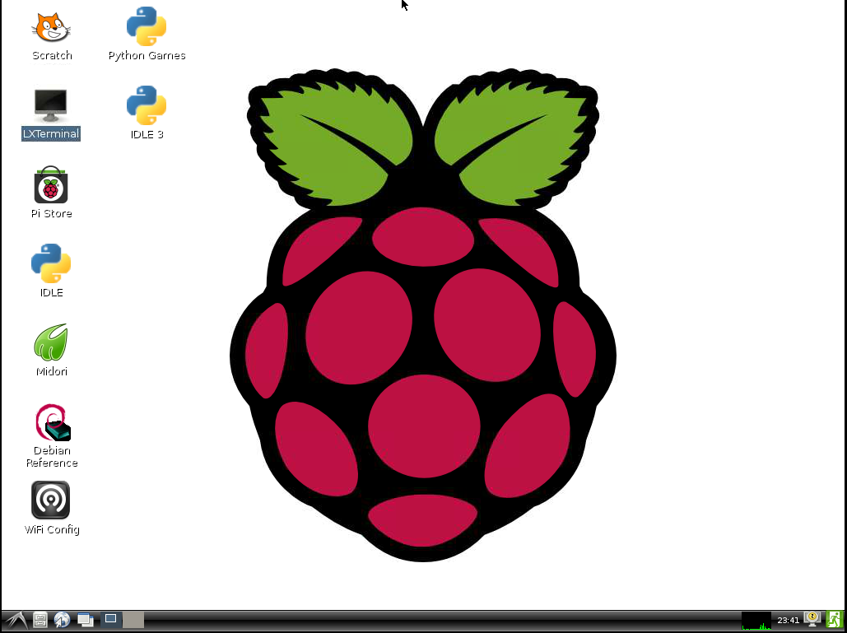
And Shazam!:

Slide 9
Oops!:
What do the LEDs mean?
LED | colour | function | normal status
ACT | green | card status | flashing during SD card activity
PWR | red | power | steady ON when Pi receives some power
FDX | orange | full duplex | on when Ethernet connection is full duplex
LNK | orange | link | on when Ethernet is connected
100 | orange | 100 Mbps | on when connection is 100 Mbps off when 10 Mbps
elinux.org/R-Pi_Troubleshooting
Most likely problem: POWER
Solution:
1. Better power adapter
2. Powered USB hub

Slide 10

Let's clear our Desk IRL P1:
Networking
If the ethernet cable is connected the adapter will get an address from DHC.
To see the details type the following command:
ifconfig -a
WiFi:
Plug your USB adapter
Click on the icon on the desktop
Ideally we want a fixed IP address, take a look at the /etc/network/interfaces file.
http://www.cyberciti.biz/faq/howto-configuring-network-interface-cards-on-debian/

Slide 11
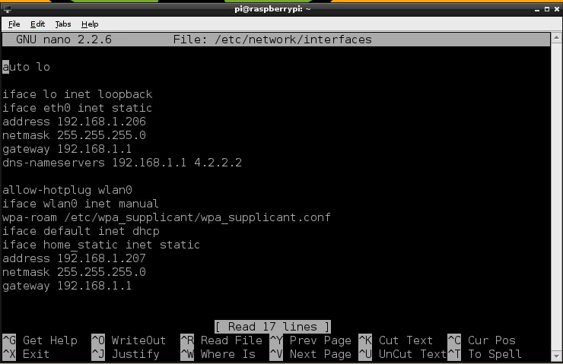
Let's clear our Desk IRL P1.b:
http://www.cyberciti.biz/faq/howto-configuring-network-interface-cards-on-debian/

Slide 12
Let's clear our Desk IRL P2:
Setting up VNC Server to autostart:
sudo apt-get install tightvncserver
tightvncserver
Provide a password when prompted. This sets a default.
wget http://www.penguintutor.com/otherfiles/tightvncserver-init.txt
sudo mv tightvncserver-init.txt /etc/init.d/tightvncserver
sudo nano /etc/init.d/tightvncserver
Then Edit this line to look like this:
su $USER -c '/usr/bin/tightvncserver :1 -geometry 1920x1080 -depth 24 '
CTRL-X, Y to close and save.
sudo chmod 755 /etc/init.d/tightvncserver
sudo update-rc.d tightvncserver defaults
sudo shutdown -r now
Source:
http://www.raspberrypi.org/phpBB3/viewtopic.php?f=28&t=11858
Install the VNC viewer on your main machine, connect to the Pi using the following connection address: xxx.xxx.xxx.xxx:1 (IP adddress of the Pi followed by a :1)

Slide 13
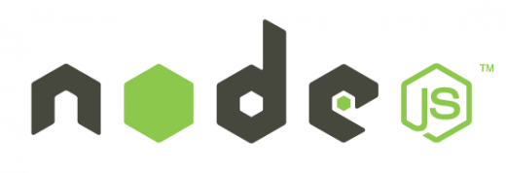
node.js
Getting and installing node.js:
sudo apt-get install nodejs
nodejs -v
That's it!!
But, wait - That is old stuff, does not have npm!
Awww, crap!
http://jeelabs.org/2013/01/06/node-js-on-raspberry-pi/
Install the VNC viewer on your main machine, connect to the Pi using the following connection address: xxx.xxx.xxx.xxx:1 (IP adddress of the Pi followed by a :1)

Slide 14
Other Things and Commands
sudo apt-get update
sudo apt-get upgrade
sudo apt-get clean
sudo uname -a
free
df -H
Install the VNC viewer on your main machine, connect to the Pi using the following connection address: xxx.xxx.xxx.xxx:1 (IP adddress of the Pi followed by a :1)

